Slide 1
ISP152 – Topic 4: Network and Operating System security
4.1 Introduction
4.2 Network security
4.3 Operating system security
4.4 Security for mobile, embedded and IoT devices

Slide 2
Module Outcomes
Demonstrate an understanding of the Open Systems Interconnection (OSI) model and common network architectures.
Identify the key hardware and software components found in computer networks.
Participate in the implementation of the basic principles that underpin the protection of information assets (identification, authentication, etc).
Identify the different stages of the operations security process, and the activities that occur within each stage.
Identify common threats affecting information security at the human level, the physical level, the network level and the application level; and outline preventative measures that can be used to eliminate or manage these threats.

Slide 3
(4.1) Introduction
In this topic, you will gain knowledge in the following areas:
4.2 Network security
4.3 Operating system security
4.4 Security for mobile, embedded and IoT devices

Slide 4
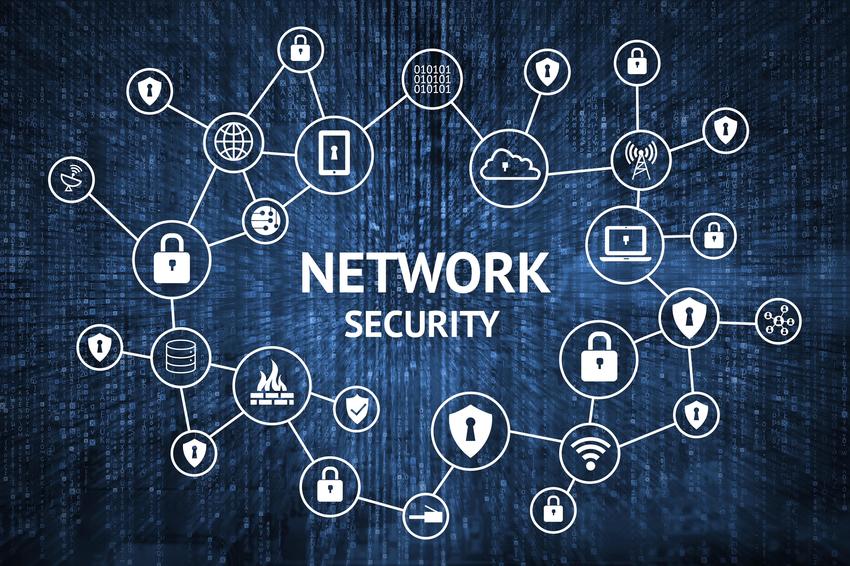
(4.1) Introduction
Network security is vital for protecting sensitive data.
Use subnets to divide networks and isolate critical data.
Firewalls control traffic and block unauthorised access.
Wireless networks must use secure encryption protocols.
Network tools and scanners enhance monitoring and protection.
Network issues can disrupt critical business operations—reliability is essential.

Slide 5
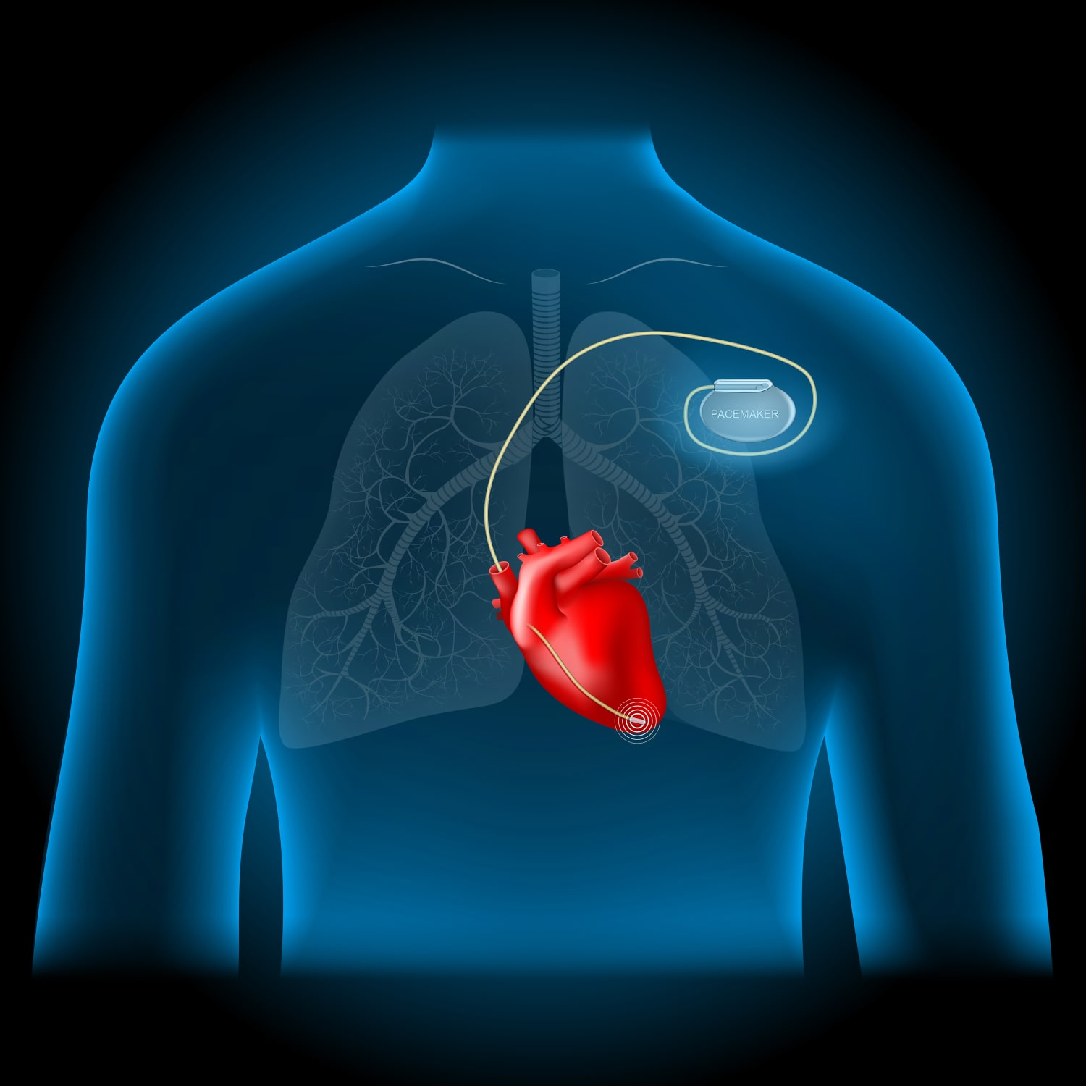
(4.1) Introduction
Operating systems help manage servers and support security:
Detect intrusions
Block/report unauthorised traffic
Prevent malware
Use vulnerability tools to find and fix weaknesses
Mobile, IoT, and embedded devices are at risk of hacking or manipulation.
Compromised embedded devices (e.g., car airbags, pacemakers) can have severe consequences.
Security of connected devices must be actively monitored and maintained.

Slide 6
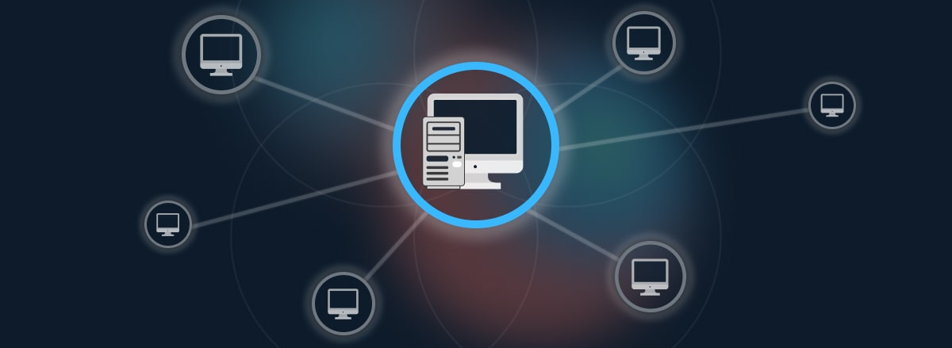
(4.2) Network security
4.2.1 Network design, firewalls and intrusion detection systems
Network security should be built into design and operations.
Network segmentation (subnets):
Improves monitoring and problem detection.
Controls traffic based on user role or department.
Choke points filter traffic between subnets.
Redundancies allow traffic rerouting if devices fail.

Slide 7
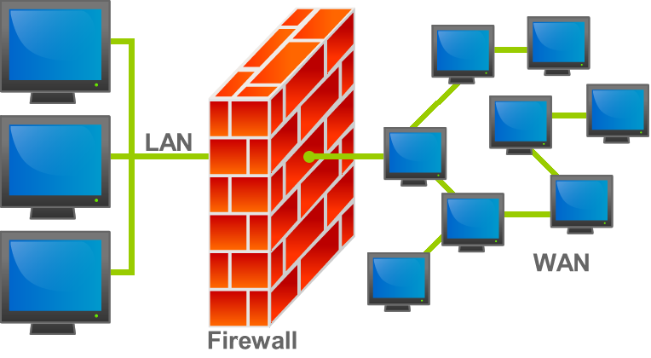
(4.2) Network security
Firewalls control traffic into and within networks:
Packet filtering: checks packet structure.
Stateful firewall: allows only valid connections.
Deep packet inspection: examines packet content.
Proxy servers: log traffic, block spam/malware.
DMZ: adds layered firewall protection for internal servers (see Andress, 2019:137).

Slide 8
(4.2) Network security
Intrusion Detection Systems (IDSs) monitor for unauthorised activity:
Signature-based: uses known attack patterns, but may miss new threats.
Anomaly-based: detects unusual activity, but may cause false alarms.
Combining both improves accuracy but can reduce network speed.

Slide 9

(4.2) Network security
4.2.2 VPNs and wireless networks
Encrypt sensitive data before sending over wired or wireless networks.
A VPN creates an encrypted tunnel between a client and a VPN server.
VPNs help protect or anonymise traffic over insecure networks.
Public Wi-Fi poses risks due to lack of encryption or shared passwords.
SSH protocol (see Andress, 2019: Ch. 13) secures communications effectively.

Slide 10
(4.2) Network security
Activity
Watch the following video:
Title: What is a VPN and How Does it Work? [SHORT Video Explainer]
Link: https://www.youtube.com/watch?v=_wQTRMBAvzg
Time allocation: 04:19

Slide 11
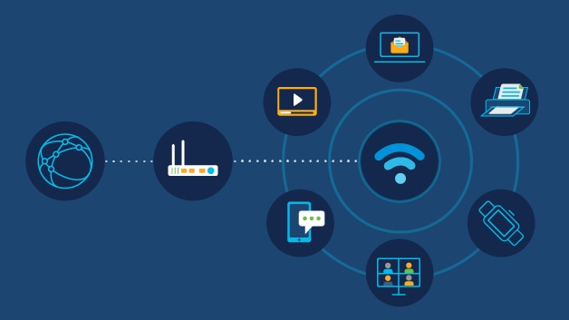
(4.2) Network security
4.2.3 Network security tools
Regular monitoring helps detect and fix network vulnerabilities.
Use attacker-like tools to test your network’s defences.
Watch for unauthorised wireless devices with specialised detectors.

Slide 12
(4.2) Network security
Key security testing tools:
Scanners: find hosts, OS types, and open ports.
Packet sniffers: capture and analyse network traffic.
Honeypots: lure attackers to study their behaviour.
Firewall tools: map firewall structure and find weaknesses.
Combine secure design, firewalls, and regular monitoring to maintain strong network security.

Slide 13
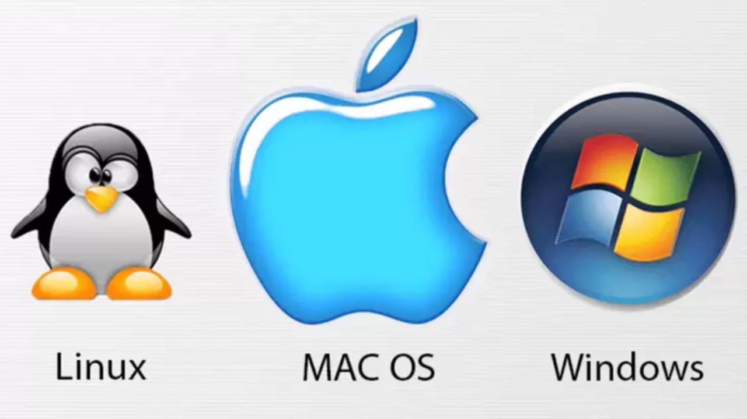
(4.3) Operating system security
4.3.1 Managing operating system security
An operating system (OS) enables basic functions of a computing device.
Common OS options: Linux, Microsoft Windows, and Apple macOS.
OS security is crucial for protecting data, processes, and applications.
Key protection methods:
OS hardening
Anti-malware tools
OS security tools

Slide 14
(4.3) Operating system security
4.3.2 Operating system hardening
Operating system hardening reduces the system’s attack surface.
Key strategies include:
Remove unnecessary software – unused apps may have vulnerabilities.
Disable non-essential services – streamline startup to reduce exposure.
Alter default accounts – remove or rename, and change passwords.
Apply least privilege – give users only the access they need.
Regularly update software – patch known vulnerabilities.
Enable logging and auditing – track login activity and system changes.

Slide 15
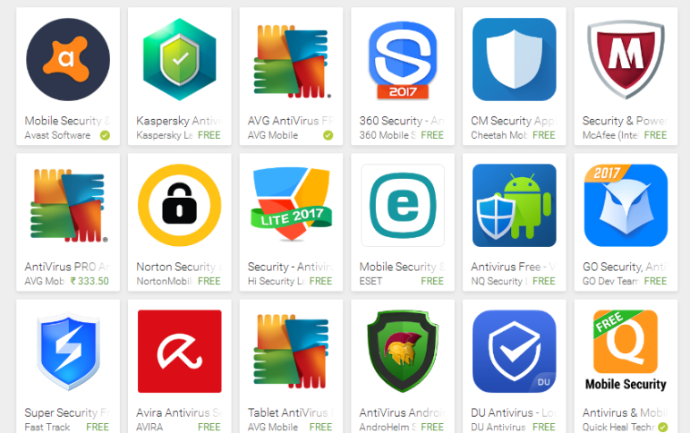
(4.3) Operating system security
4.3.3 Anti-malware tools
Anti-malware tools protect operating systems from attacks.
Anti-malware apps detect threats via malware signatures or unusual behaviour; threats are deleted or quarantined.
Executable space protection blocks code execution in certain memory areas, stopping some malware.
Software firewalls & host intrusion detection add advanced intrusion rules and management on top of basic firewall hardware features.

Slide 16
(4.3) Operating system security
4.3.4 Operating system security tools
Security tools for host assessment include:
Scanners: detect open ports and identify running services/versions.
Vulnerability assessment tools: find known weaknesses in network services.
Exploit frameworks: simulate attacks using software flaws to test defences.
Combine these with firewalls, OS hardening, and regular monitoring for strong network security management.

Slide 17
(4.3) Operating system security
Activity
Watch the following video:
Title: Basics for building a System Security Plan - SSP
Link: https://www.youtube.com/watch?v=DEr5SS66Ko4
Time allocation: 03:43

Slide 18

(4.4) Security for mobile, embedded and IoT devices
4.4.1 Security for mobile, embedded and IoT devices
Info security must also cover mobile and embedded devices, not just computers.
Mobile devices (smartphones, tablets, smartwatches):
Mobile Device Management (MDM): centrally manages org-owned devices, enforces updates, passwords, app controls.
BYOD policies: regulate personal device use, but harder to monitor.
Baseband OS (controls hardware) often receives infrequent updates, increasing risk.
Jailbreaking disables security features and exposes devices to malicious apps.

Slide 19


(4.4) Security for mobile, embedded and IoT devices
Embedded devices:
Built into other devices (e.g., car airbags, pacemakers, water quality monitors).
Common in medical and industrial control systems — must be secured against attack.

Slide 20
(4.4) Security for mobile, embedded and IoT devices
Activity
Watch the following video:
Title: What is an Embedded System and What Does it Do?
Link: https://www.youtube.com/watch?v=d3N_Zuu2bqA
Time allocation: 01:33

Slide 21
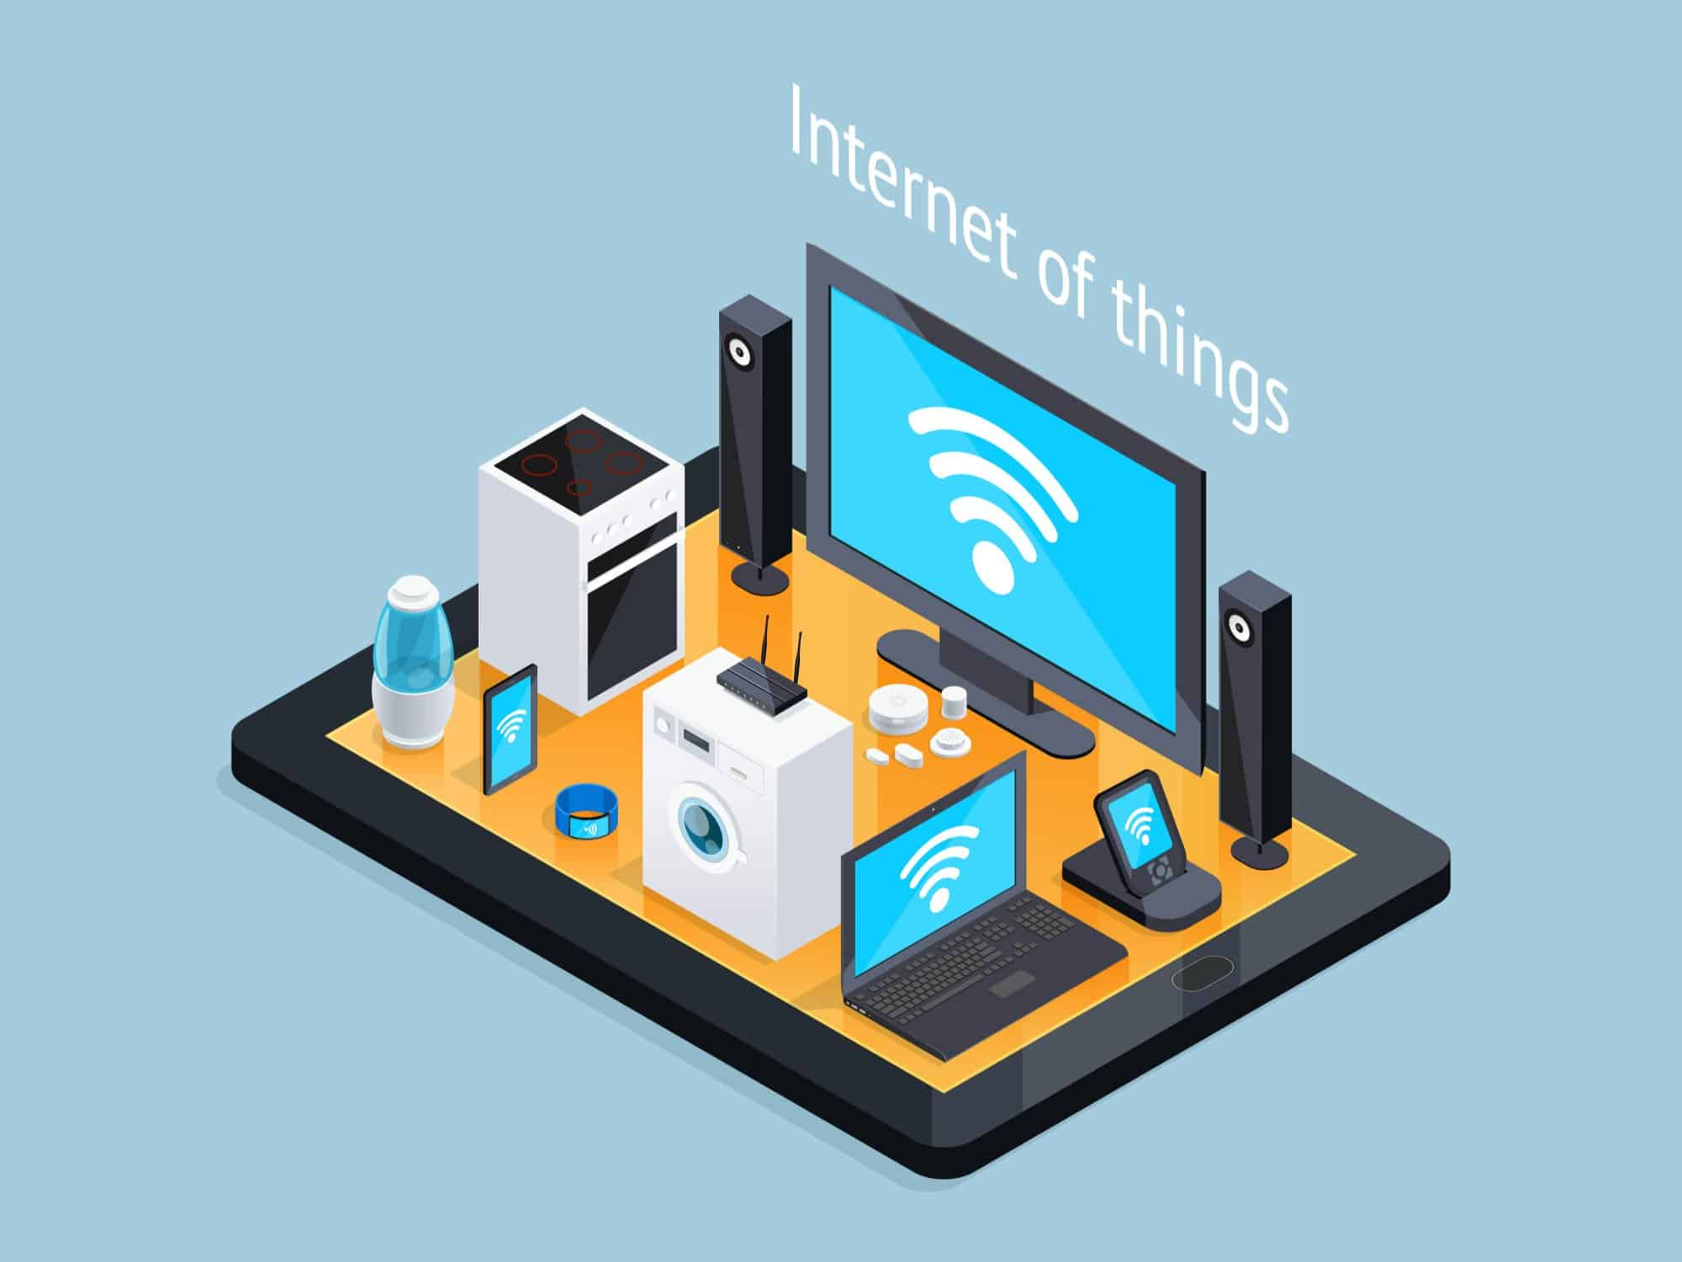
(4.4) Security for mobile, embedded and IoT devices
IoT devices are internet-connected but don’t run full desktop operating systems.
Examples: network printers, home security systems, environmental monitors.
Their network connectivity makes them difficult to secure and vulnerable to attack.

Slide 22
(4.4) Security for mobile, embedded and IoT devices
Activity
Write down two innovative features involving IoT devices that could enhance the functioning or performance of self-driving vehicles.
Time allocation: 10 minutes

